Slide 1



E-Commerce platform for Metropolia students
Group 4
Nhi Dinh
Kim Tran-Do
Tu Dinh
Trung Doan

Slide 2
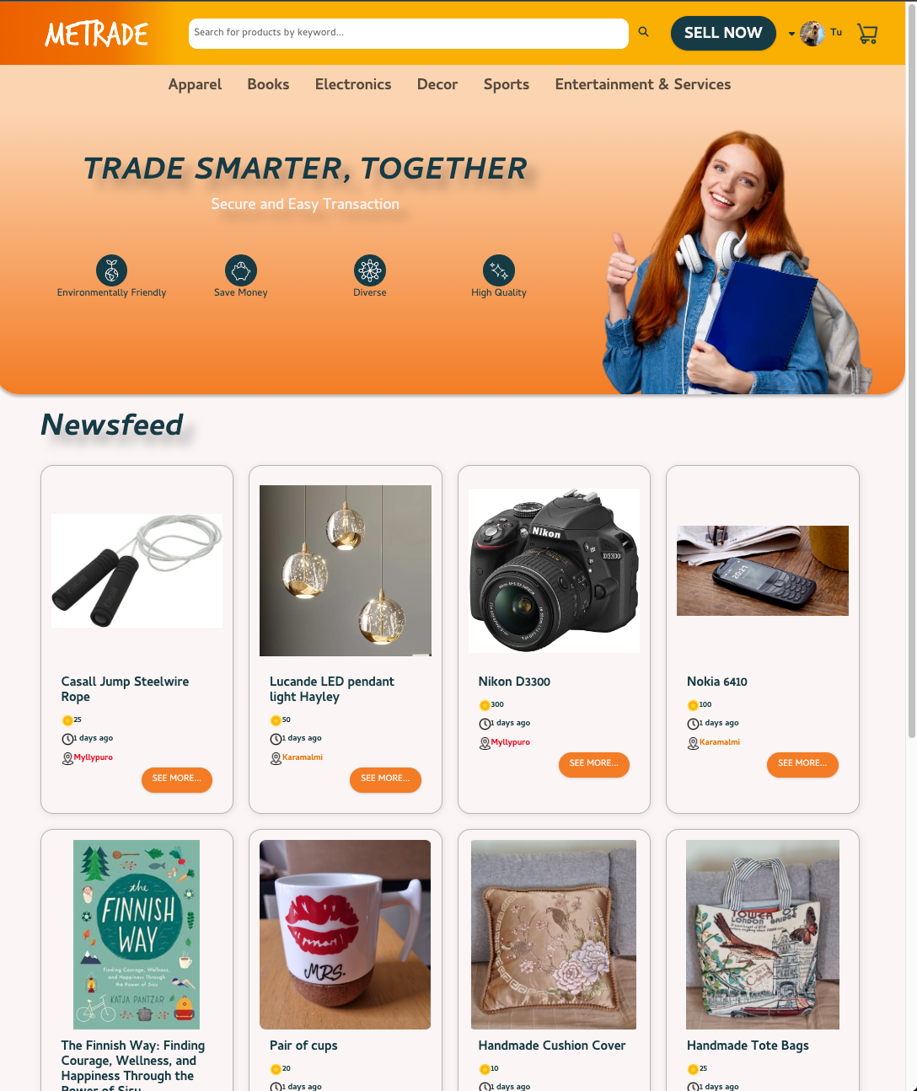
Agenda
Metrade ecommerce website
Sprint 1 comparison and enhancements
Progress discussion

Slide 3
Key changes and enhancements
Store authentication tokens in cookies (not local storage)
Display stock and cart quantities on product detail page
Integrate cart and checkout features
Extra feature: Edit products in selling inventory

Slide 4
Sprint 3 progress conclusion
Objectives:
Finalize user purchasing functionality
Complete selling-specific features
Achieve full platform administration capabilities
Outcomes:
Delivered all planned features successfully
Smooth collaboration on GitHub
Product delivered on schedule
Challenges & Solutions
Challenge: Code merging at the end of each sprint
Solutions: Implemented a structured merge process where each member merged in sequence. Before each merge, the application is thoroughly checked to ensure it ran smoothly with new code.

Slide 5




Sprint 3 contributions
Nhi – Product Owner
Authentication system using cookies and pair token
Shopping cart feature and checkout system
Tu
Scrum Master
Inventory page for sellers
User management page for admin
Initial Task Discussions
Clarified requirements with Product Owner
Frequent Check-ins
Daily updates
Meetings
Mid-Sprint Code Review
Code walkthrough
Address potential issues
Sprint Retrospective
Features presentation
Merge code
Trung
Fullstack developer
Purchase history page
Transaction management page for admin
Kim
Fullstack developer
Product listing and editing page for sellers
Product management page for admin

Slide 6
Thank You

